Slide 1

Firebird Hacks Opening Ceremony

Slide 2
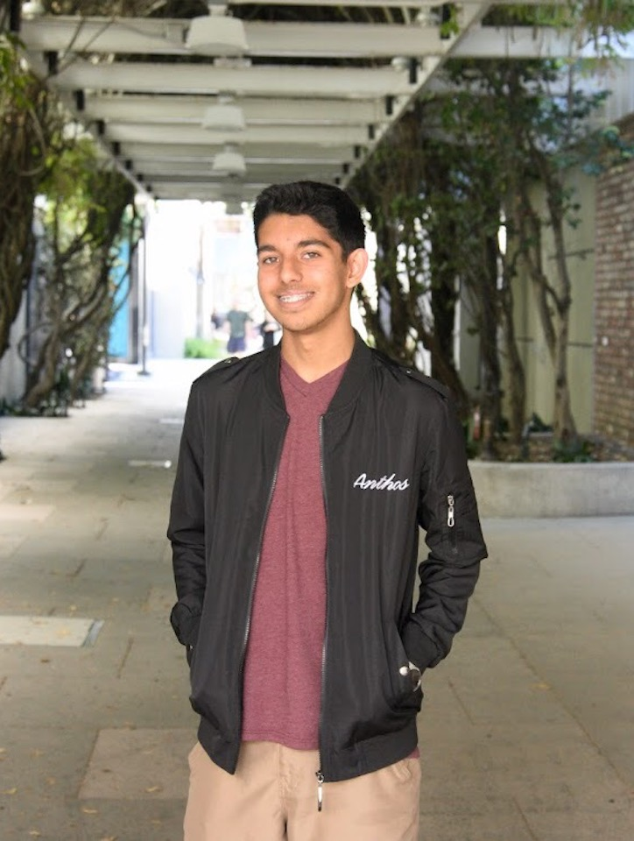
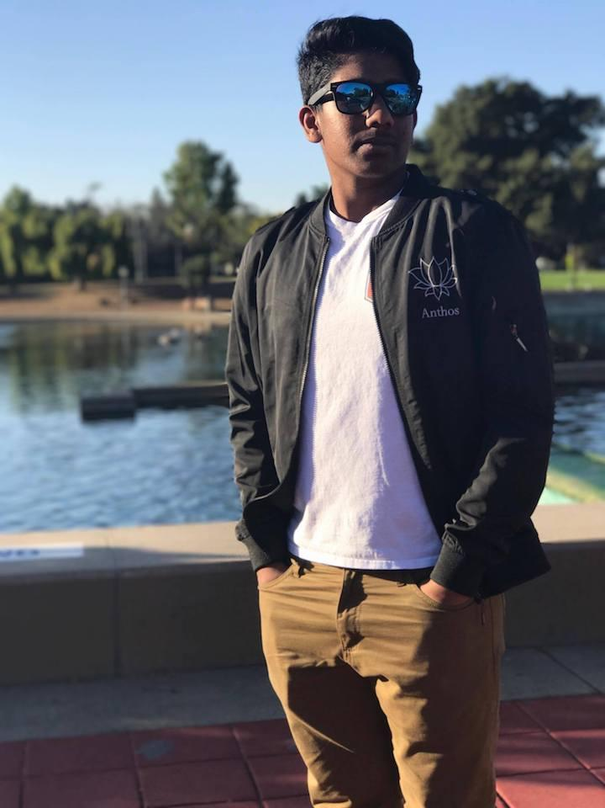
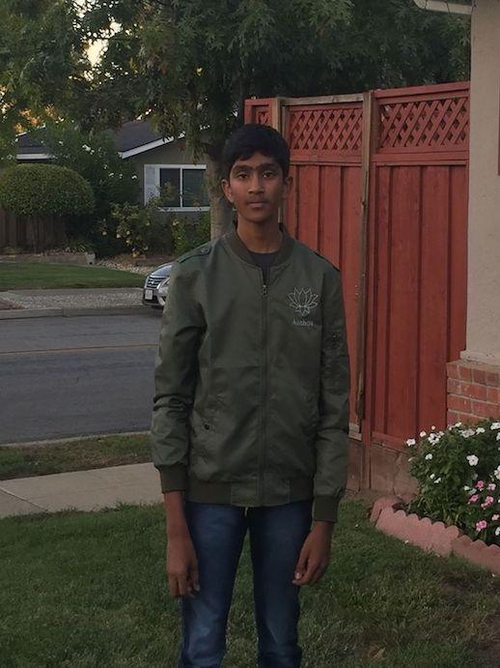
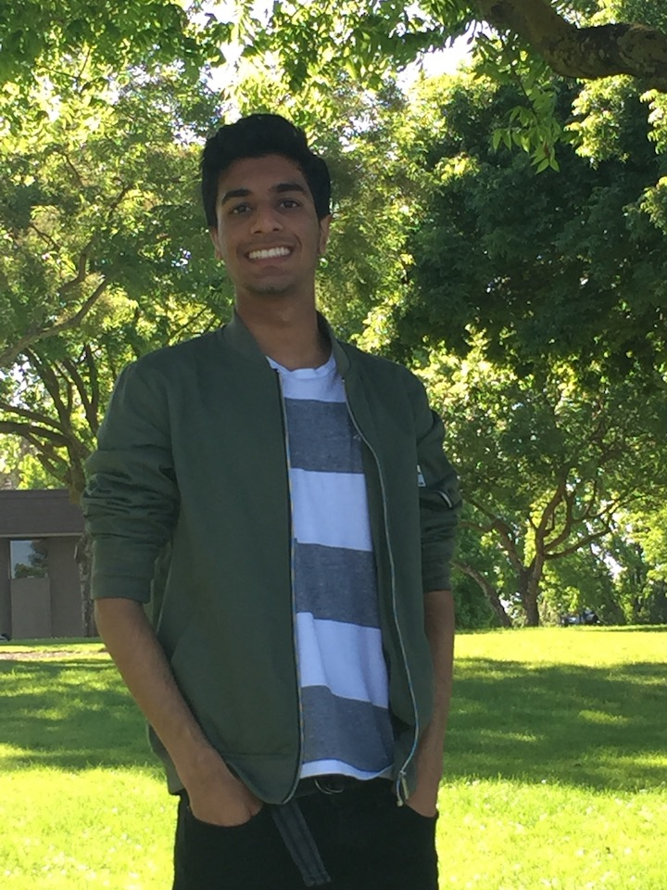
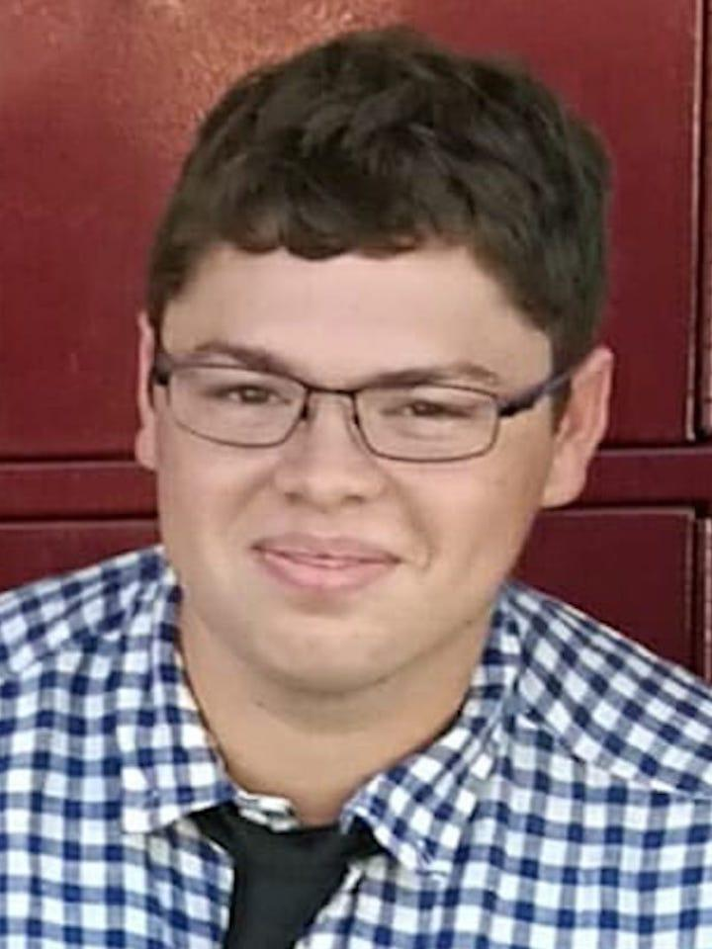
Meet Our Team
Rohan Rodrigues
Ganesh Susarla
Atharva Shende
Abhinav Mamidipaka
Aneesh Goel
Assaf Vayner

Slide 3
Project Building Process
Form Team
Brainstorm project ideas
Begin coding
Submit your projects at the end

Slide 4

Hackathon Schedule Day 1
9:00 am - Check-In
10:00 am - Kick Off Presentation
10:30 am - 24 hour hackathon clock starts
11:30 am - 12:30 pm - HTML/CSS Workshop by Hackerfund
1:00 pm - Lunch
3:30 pm - 4:30 pm - Rails Workshop by Hackerfund
5:00 pm - Raffle
7:30 pm - Dinner
9:00 pm - Raffle Winners Announced

Slide 5

Hackathon Schedule Day 2
12:00 am - Midnight Snack
8:00 am - Breakfast
10:00 am - Submissions due on Devpost
10:30 am - 11:15 am - Project Pitching
11:30 am - 12:00 pm - Awards/Closing Ceremony

Slide 6
Credits
Special thanks to all the companies and people who have helped make this event happen!

Slide 7


























Sponsors

Slide 8
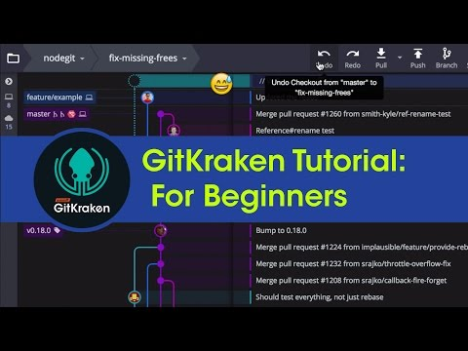
Special Video From GitKraken
Follow them on Twitter @GitKraken and on YouTube

Slide 9

Powering High School Student Startups
GO TO www.leangap.org

Slide 10
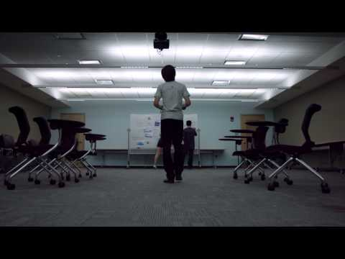

Slide 11
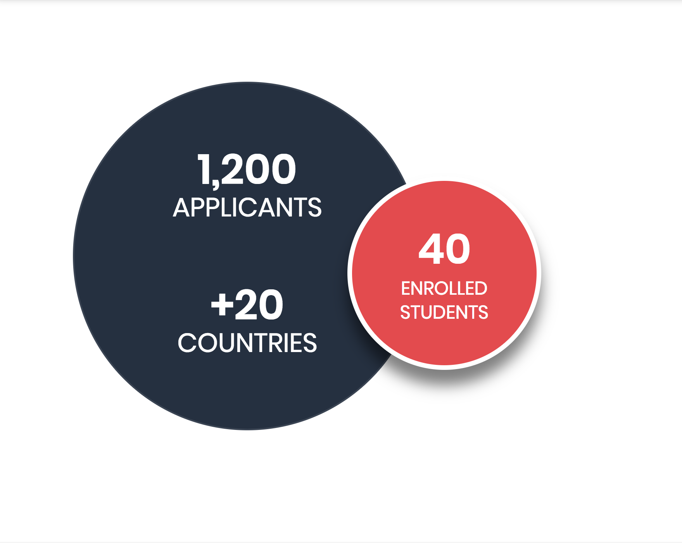

Each summer, we select 40 of the world’s brightest and most ambitious high school entrepreneurs to Leangap.

Slide 12
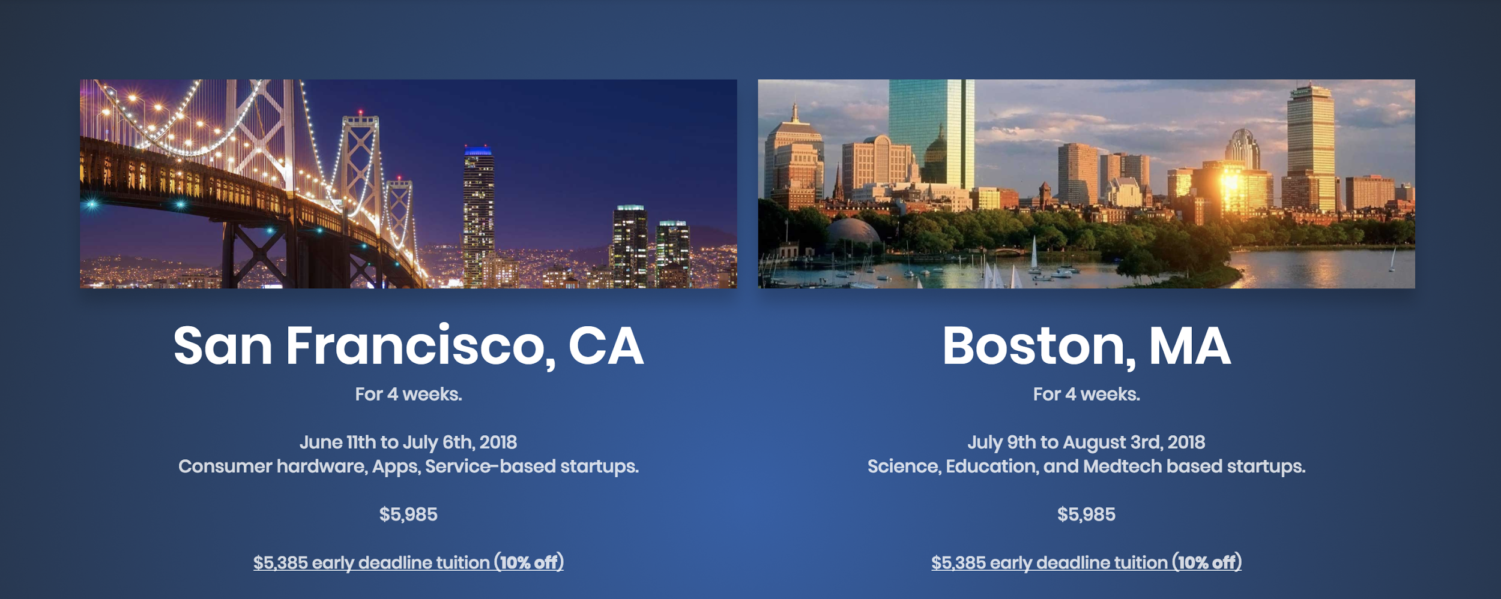

Slide 13
Come with an idea.
Leave with a real, scaleable company.

Slide 14
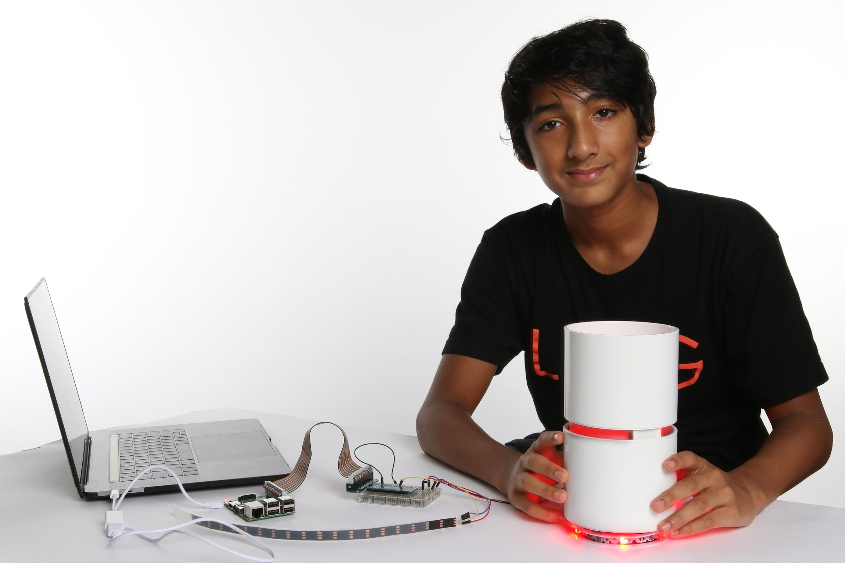
Arun Rau
14 Years Old
Raised $10k on IndieGogo with Crescent

Slide 15
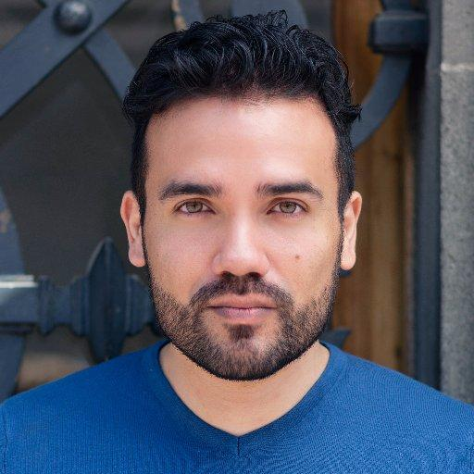
Sadok Cervantes
Designer for Lufthansa, MIT, Springboard, Careerfoundry.
Named by Fast Company as one of 2017’s most influential designers in the world.

Slide 16
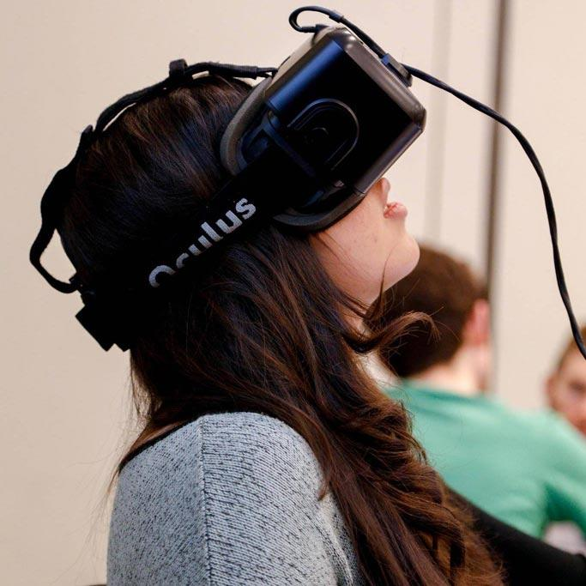
Gemma Busoni
Cofounded VR company Discovrlabs at the age of 16.
Shared the cover of Seventeen magazine with Michelle Obama
after winning the White House’s #bettermakeroom award.

Slide 17
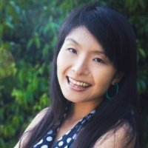
Ning Shirakawa
Pioneered Asia’s entrepreneurial education for students after graduating Duke and MIT Sloan.
Founder of Taktopia & Co.

Slide 18
Alumni Statistics
75% of companies started at Leangap continue past the summer.
Every team builds a working, presentable prototype of their product/service.
Every team attains real, paying customers or users.

Slide 19
TODAY @ FireBird Hacks:
We are offering a $500 scholarship to every attendee. To qualify, follow these steps:
Go to www.leangap.org
Click Apply
Click “Sign Up With Facebook”

Slide 20
Join our Slack and Devpost
Slack: goo.gl/ri5j2w
Devpost: https://firebird-hacks-5741.devpost.com/

Slide 21
Happy Hacking!

